Slide 1


Bare Essentials
Connecting people to homes
Jesse Belleau-Karaskewich, Ethan Davis, Brian Vaughan

Slide 2
At a Glance
Our Goal
What is Bare Essentials?
How does it work?
Who does it help?
Government proposals
What's next?

Slide 3
Our Goal
The Bare Essentials team seeks to answer two questions
In Barrie’s current real estate market, how can we increase the rate of first time home buyers?
And how can we provide stable, affordable housing for lower income individuals?

Slide 4
Case Study
Consider a couple Jack and Diane
They have one child
The family are Barrie residents and have a an annual income of $50k
At the 5% down payment the only affordable mortgage they qualify for is $274 000
The lowest priced house they can find is $350 000 and it has one extra bedroom
Buy using the Bare Essentials program they can now qualify for a $390 000 home with a 5% down payment

Slide 5
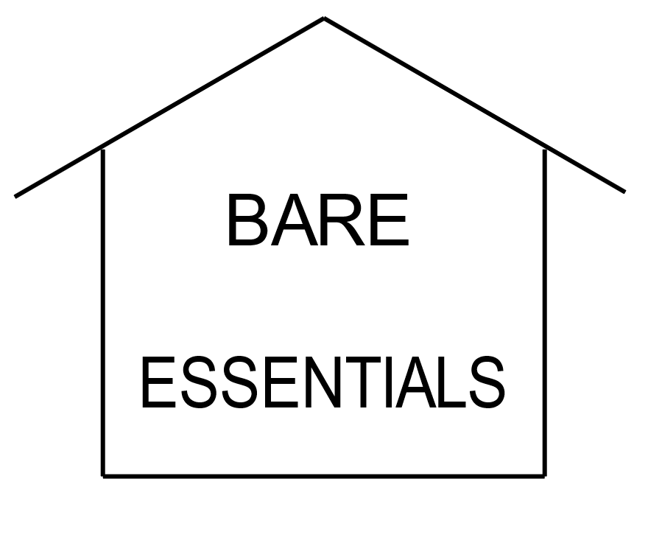
What is Bare Essentials?
Barrie Affordable Real Estate Application
Seeks to secure mortgages for first time home buyers by considering supplemental revenue streams
While synergistically securing housing for lower income individuals

Slide 6
How It Works
Bare Essentials is a mortgage calculator that includes a contractual agreement to utilize the residence as a revenue source
Primarily by renting out one of their rooms on a monthly bases or booking it out as a bed and breakfast for 10 nights a month
Additionally by using government incentives to install renewable energy resources and putting energy revenue towards mortgage payments

Slide 7
How It Works: Required Annual Income
Based on:
The average selling price of home
inside the city of Barrie $507 000
With a 5% down payment
Note:
The average Barrie household income is $77 904
Sources | Required Income
No additional source | $93 600
Solar Panels | $75 000
Room Rental/Bed and Breakfast | $72 000
Both | $52 800
*Monthly average room rental $550/month
*Bed and breakfast $60/night
*Solar power revenue $5694/annum

Slide 8
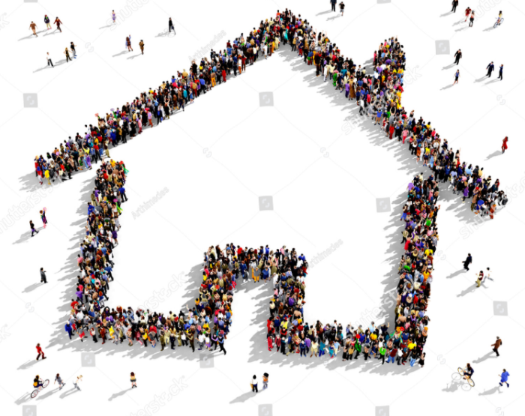
Who Are We Helping?
This project targets first time home buyers, providing buyers with means to purchase a house in the current market
Synergistically provides housing for lower income individuals in a sustainable, affordable environment

Slide 9

Proposals for Change
Amendment to CMHC or lending agency to allow potential home revenue as source of income, a contractual obligation would result in a guarantee
For first time home buyers, all residential revenue would be going towards mortgage payments, incentivize buying by making this revenue tax free similar to an RRSP
Provide better renewable energy installation incentives, the current Bruce Power and Darlington rebuild budget could fund the most expensive solar technology installations for 70% of the houses in the province

Slide 10
What’s Next?
Integrate BDAR real estate data streams into Bare Essentials for access to up to date listings
In collaboration with BDAR, develop a pairing system to match home buyers and tenants; beginning with a pairing application and following with an interview stage
With the influx of solar technology transition Barrie to a Smart Grid, have Barrie lead Canada in cost efficient green energy

